Slide 1
Cloud Security
Securing your microservices on cloud
Sreekanth Iyer
Cloud Security Architect, IBM Watson and Cloud Platform - Developer Services
IBM Master Inventor, Open Group Certified Distinguished Architect
email sreek.iyer@in.ibm.com Twitter: @sreek Blog : http://ibm.co/sreek

Slide 2

Cloud presents an opportunity to radically transform security practices
Traditional Security
Manual, static, and reactive
Dynamic Cloud Security
Standardized, automated, agile, and elastic
Cloud security should enable business innovation, improve defenses and reduce risk

Slide 3



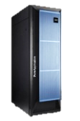


Securing Cloud-native Applications & Workloads
Develop & Deliver cloud services securely
Identity & Access
Manage access to cloud workloads
Secure infrastructure & applications in the Cloud
Protect data at rest and in transit
Gain security visibility across hybrid deployments
Network Security
Data Security
Public Cloud
Private Cloud
Secure Dev-Ops
& Application Security
Security Intelligence & Monitoring

Slide 4
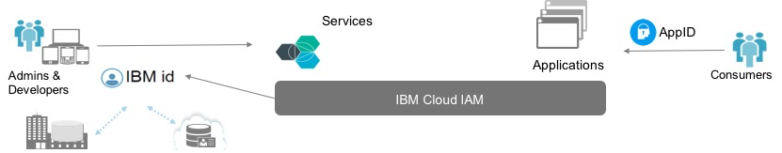
Identity & Access Management
Identity and access management is key to Cloud adoption
Identity & Access
Platform identity & authentication e.g., Developers login to Bluemix using IBM id
Granular access control
e.g., Configure that security admins can change encryption keys
Application identity integration
e.g., Banking customers login to mobile apps, using App ID service
App ID
Cloud IAM
Application user authentications
Developer focused APIs, SDKs
Omni-channel interactions – web, mobile, IoT
Network Security
Foundation to IBM Cloud & Digital
Authentication & Federation
SSO with IBM.com applications
Service IDs and API keys
Service level access control
Object level enabling privacy
Consistent model across services, roles, users and apps
Data Security
Secure Dev-Ops
& Application Security
Security Intelligence & Monitoring
https://developer.ibm.com/cloudarchitecture/docs/security/securing-workloads-ibm-cloud/identity-access-management/

Slide 5
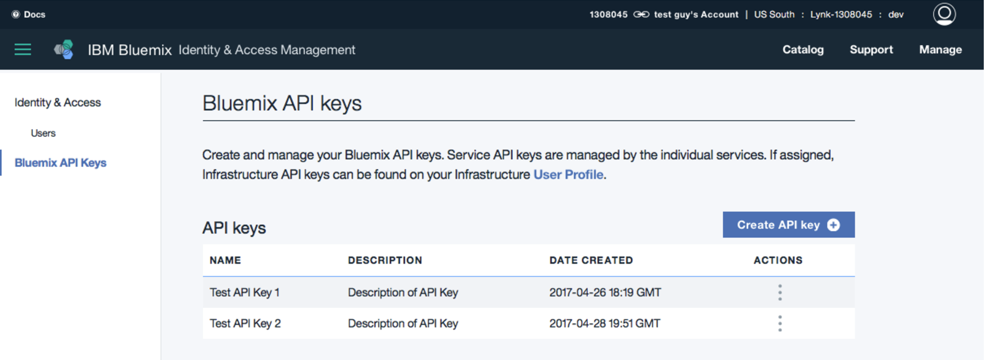
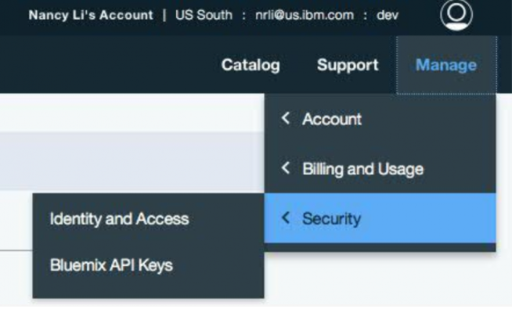
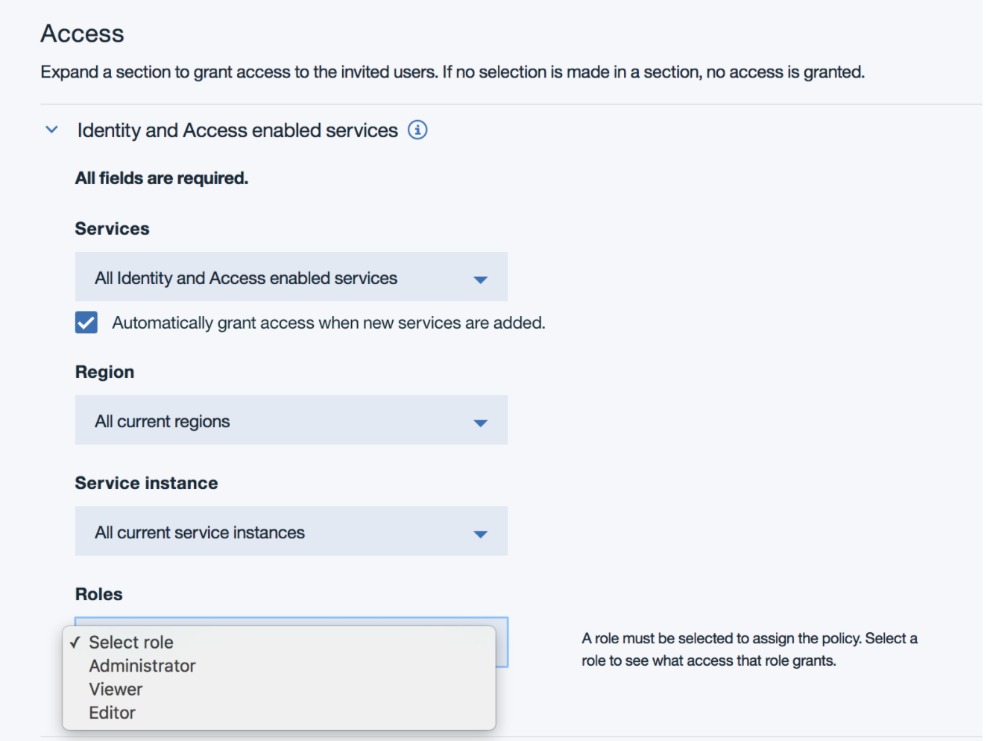
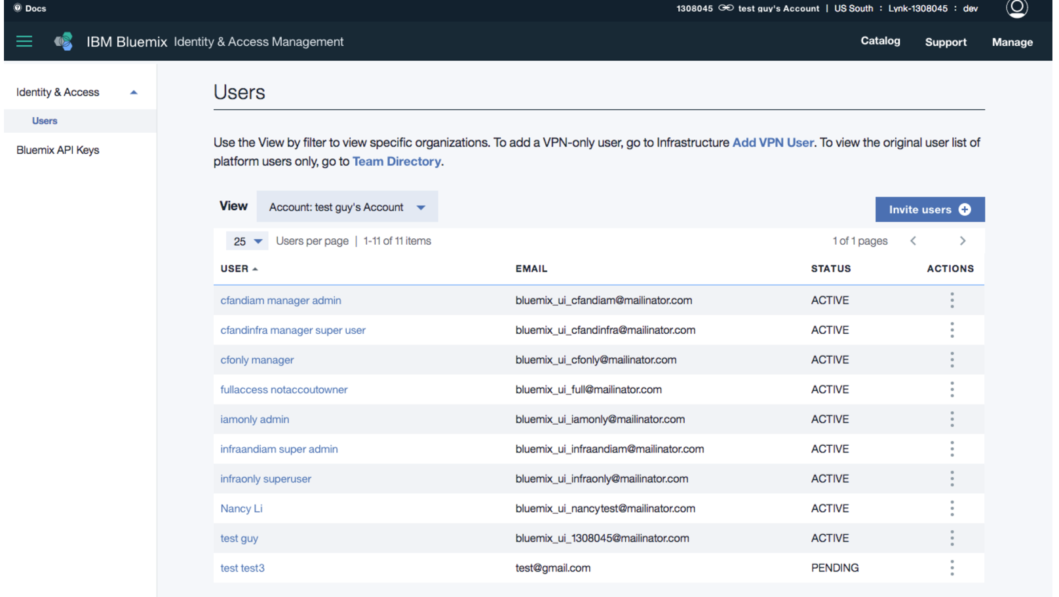
Cloud Identity & Access Management
API keys for user authentication
Unified user management across Bluemix Platform and Infrastructure services
Fine-grained access control
https://www.ibm.com/blogs/bluemix/2017/05/introducing-identity-access-management/

Slide 6
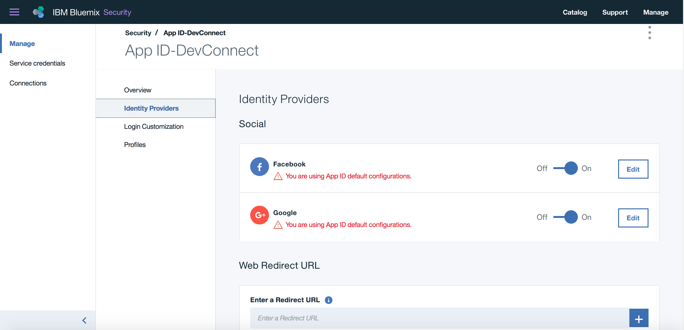
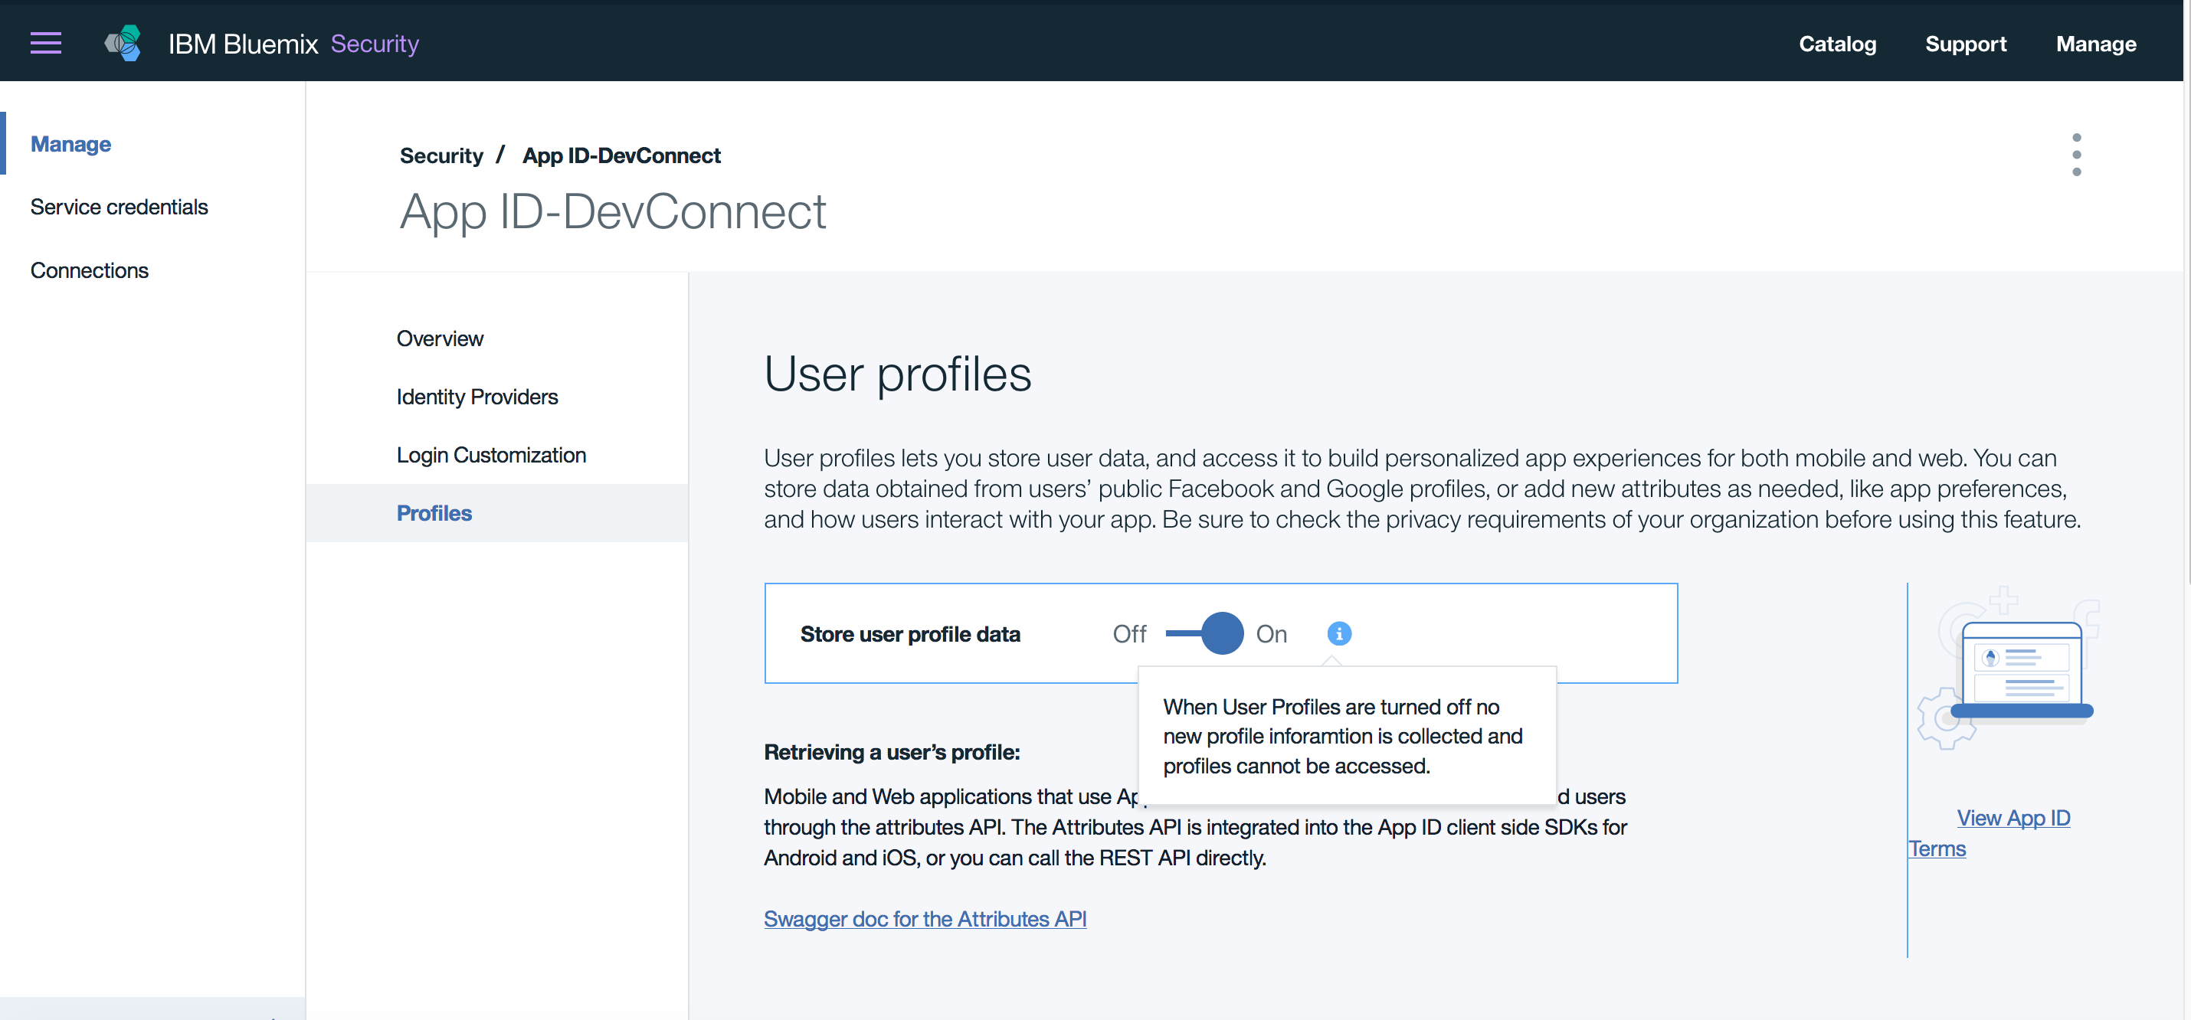
App ID
SDK-s and REST API-s
Deliver tailored experiences for your users using Profiles
Protect your backend resources
Get a sign-in flow working in minutes
Prebuilt functionality for social log-in
Quickly on-board
https://console.bluemix.net/catalog/services/app-id

Slide 7



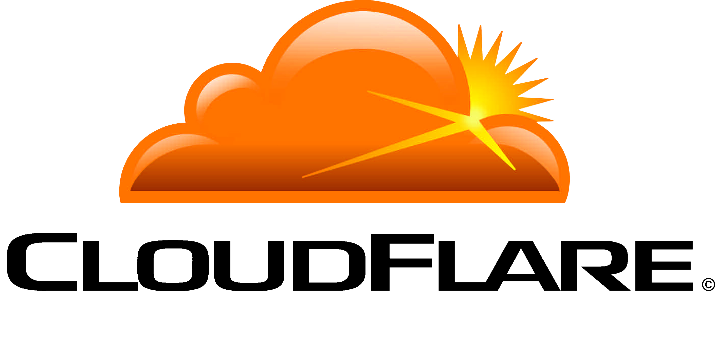

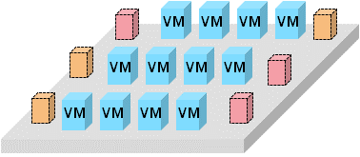




Network Security
Re-define network micro-perimeters and network protection, enabling defense-in-depth
Identity & Access
Network security from the Cloud
e.g., Customers use Akamai to protect banking app from DDoS attacks
Firewalls & IPS are table stakes e.g., Customer uses firewall and IPS to build DMZ in Cloud
Micro-segmentation is evolving
e.g., Isolate data tier from web apps using network segments
Network Security
Cloud hosted proxies
Cloud-scale protection from DDoS
Web application firewalls
Firewalls, Intrusion Prevention (IPS)
Web application firewalls
VPN for enterprise connectivity
Software defined networks
Network security groups
Workload-centric connectivity and security
Data Security
Secure Dev-Ops
& Application Security
Cloud Security Proxy
data zone
Analytics
Security Intelligence & Monitoring
Apps & services
cloud “dmz”
https://developer.ibm.com/cloudarchitecture/docs/security/securing-workloads-ibm-cloud/network/

Slide 8
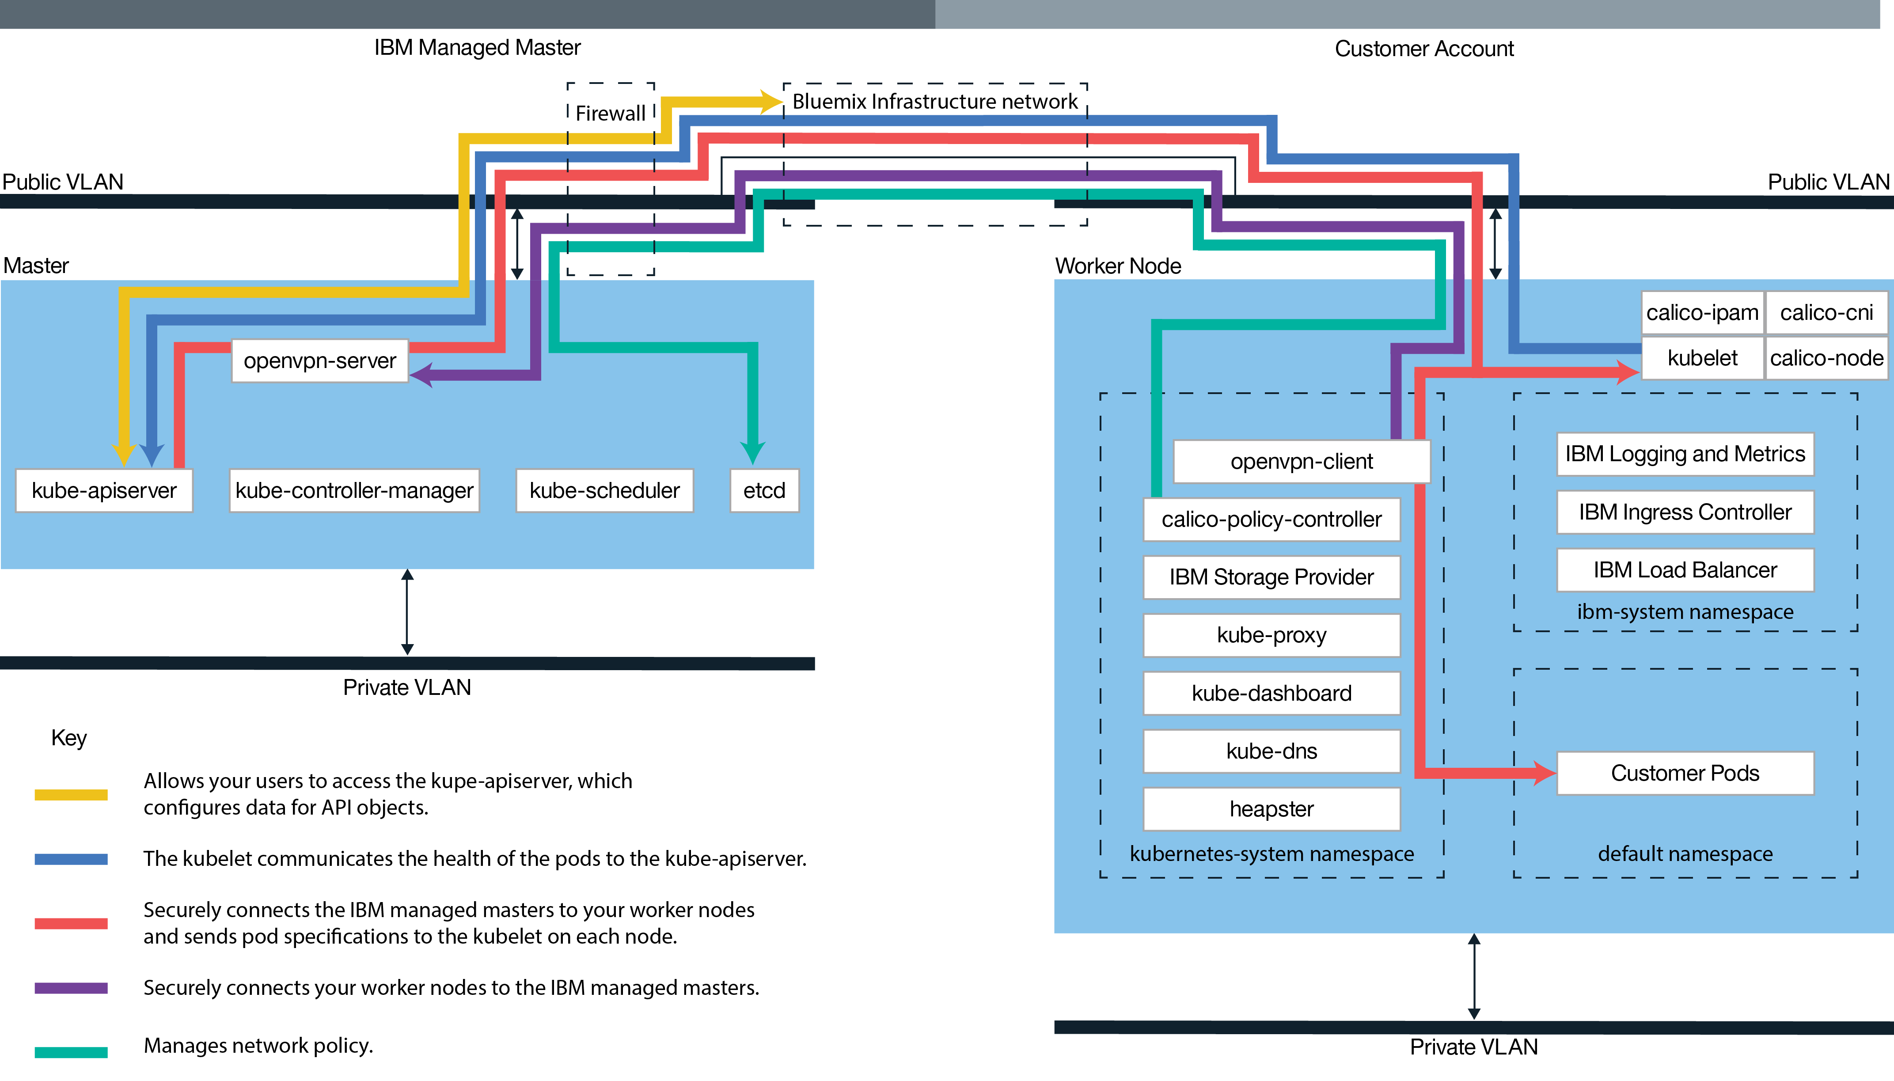
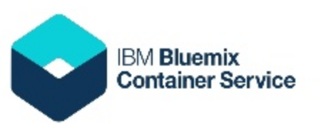
Leverage isolation, with IBM Bluemix Container Service, for micro-services deployments
Firewall Protection
Compute, Network, Storage Isolation
Load balancer + Ingress Support
TLS Security from Worker to Master
Dedicated per Customer
Continuous monitoring + logging
https://console.ng.bluemix.net/docs/containers/cs_planning.html#cs_planning

Slide 9
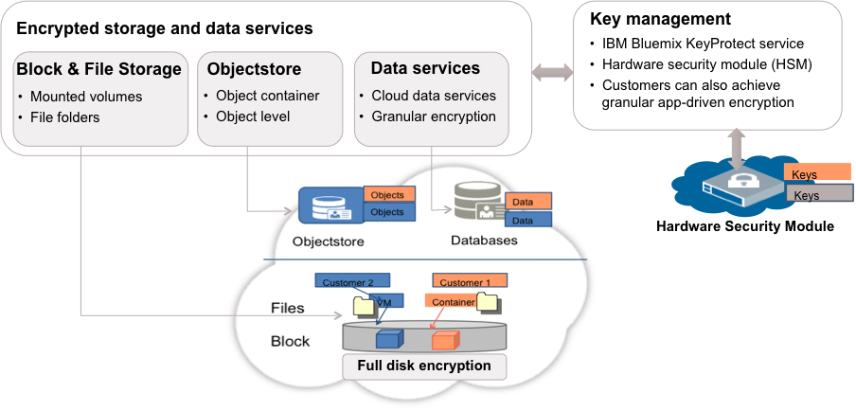
Data Security
Protect your sensitive data with encryption and IBM Cloud key management
Classification-based decisions
e.g., CISOs decide that confidential data should be deployed in Bluemix Dedicated
Policy driven encryption
e.g., Objects are encrypted in ObjectStore with Provider managed keys
Key management e.g., Customer uses IBM KeyProtect to create their encryption keys
Identity & Access
Sensitive data stays on-prem
Confidential data considered
Regulatory compliance drives decisions
Encryption across storage types
Files, Block, Objects, and Data services
Policies reflecting data separation and risks
Key management service
Hardware security modules
Application-level encryption for granular data security
Network Security
Data Security
Secure Dev-Ops
& Application Security
Security Intelligence & Monitoring
https://developer.ibm.com/cloudarchitecture/docs/security/securing-workloads-ibm-cloud/data/

Slide 10
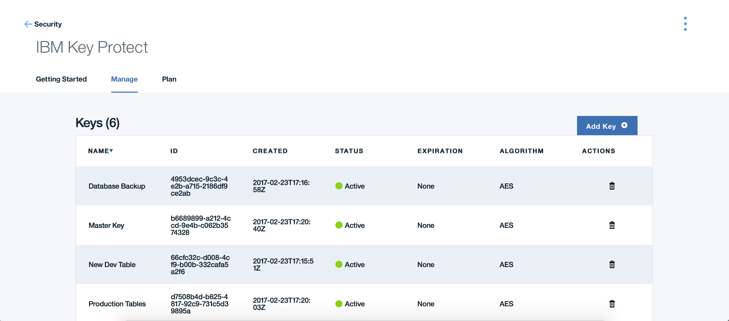
Key Protect
Application Independence – Programmatic APIs to manage your keys
Scalable from few keys to millions of keys
Root of Trust (RoT) backed by Hardware Security Module (HSM)
Life cycle management of encryption Keys
Activity Tracking logging enabled
https://console.bluemix.net/catalog/services/key-protect

Slide 11
Secure Dev-Ops & Application Security
Identity & Access
Achieve continuous security as part of DevOps and not as an after thought
Network Security
Containers enables new model e.g., Customer uses Vulnerability Advisor to assess container images
VMs are still traditional e.g., Customer uses BigFix to patch all VMs and fix Linux security vulnerability
Application security e.g., Customer uses Application Security service to scan web apps and mobile
Data Security
Vulnerability analysis
Enterprise security policies
Remediation in devOps
Configuration and patch management
VMs based models for lift & shift apps
Compliance reporting
Application security scanning
Mobile and web apps
Secure engineering and proactive
Secure Dev-Ops
& Application Security
Security Intelligence & Monitoring
https://developer.ibm.com/cloudarchitecture/docs/security/securing-workloads-ibm-cloud/devops/
https://developer.ibm.com/cloudarchitecture/docs/security/securing-workloads-ibm-cloud/applications/

Slide 12
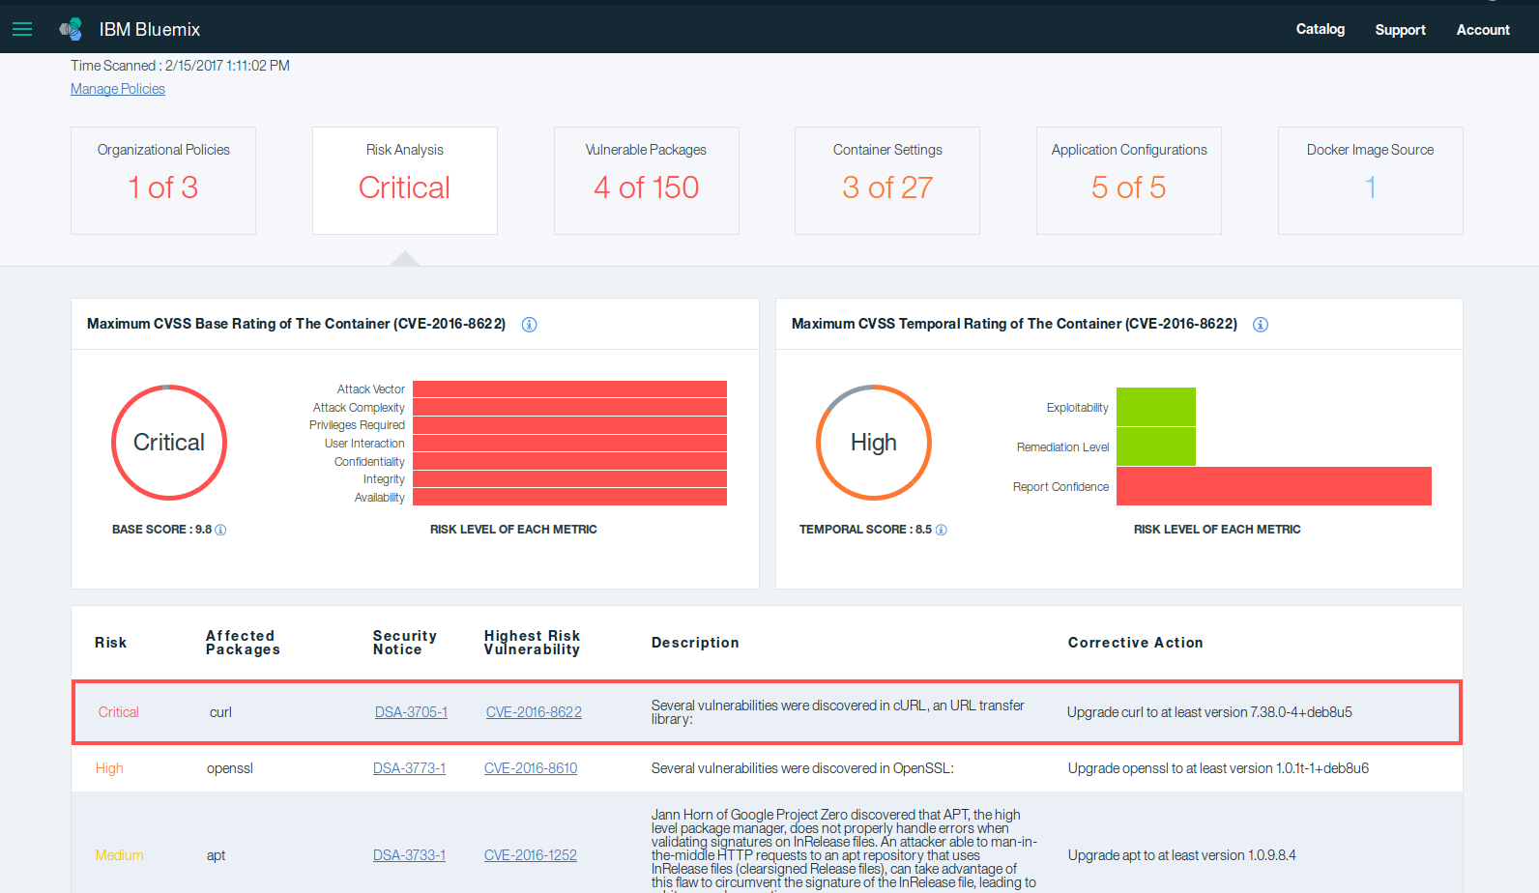

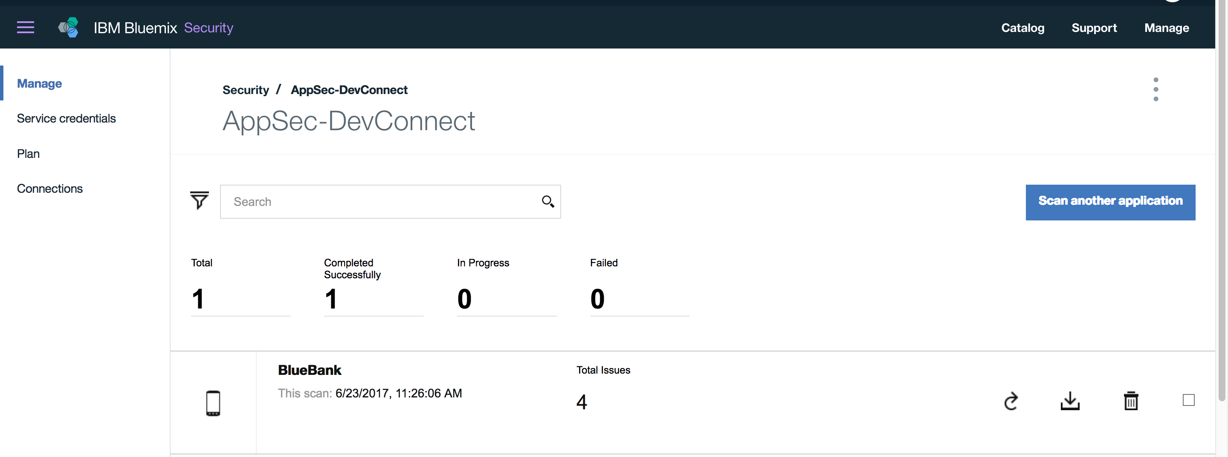
Container Vulnerability Advisor & Application Security on Cloud
Risk Analysis and Manage Organization level Policies
Integrate with Dev-Ops tool chain through APIs
Scans Images and Containers for vulnerabilities
Detailed reporting and offers best practices to remediate vulnerabilities.
Assess software code, web and mobile apps (Source & Dynamic)
Checks for Vulnerable Packages in Containers
https://console.bluemix.net/docs/containers/va/va_index.htm
https://console.bluemix.net/catalog/services/application-security-on-cloud

Slide 13
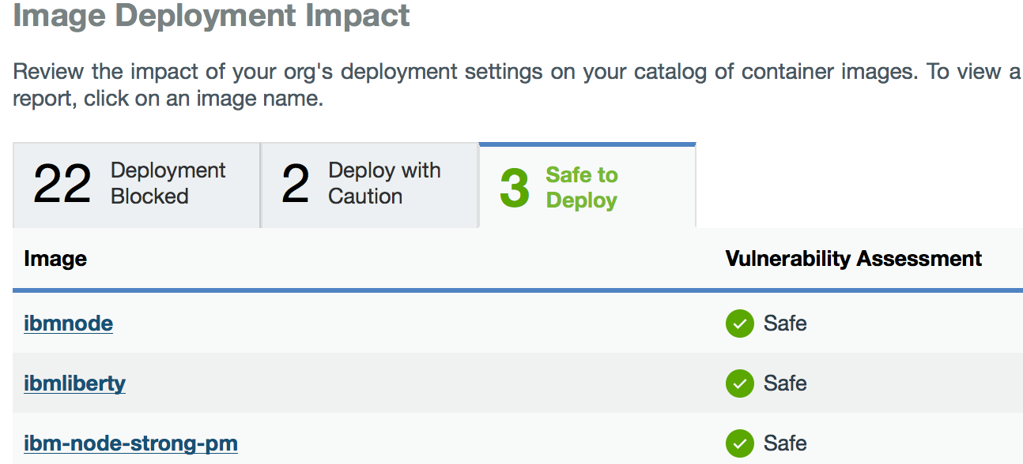




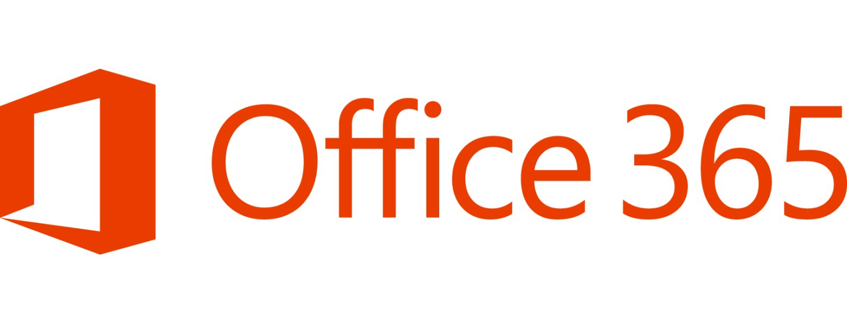

Security Intelligence & Monitoring
Gain confidence with visibility and security intelligence
Identity & Access
Activity Tracker and audit logs e.g., All administrative access is logged in Bluemix
Identify Cloud incidents
e.g., Customer uses analytics tools to correlate Cloud traffic to identify malicious app
Enterprise security intelligence e.g., CISO wants all logs and events integrated into their on-prem SIEM
Log all access to platform and services
API, web and mobile access
Application logs integration
Security and vulnerability posture
All platform logs and events
Continuous monitoring for attacks and threats
Integrated view across hybrid deployments
Cloud and on-prem security monitoring
Incident management and reporting
Network Security
Data Security
Secure Dev-Ops
& Application Security
Customer workloads
Cloud security logs & reports
Enterprise SIEM/ SOC
Security Intelligence & Monitoring
Enterprise
security logs & reports
https://developer.ibm.com/cloudarchitecture/docs/security/securing-workloads-ibm-cloud/intelligence-monitoring/

Slide 14
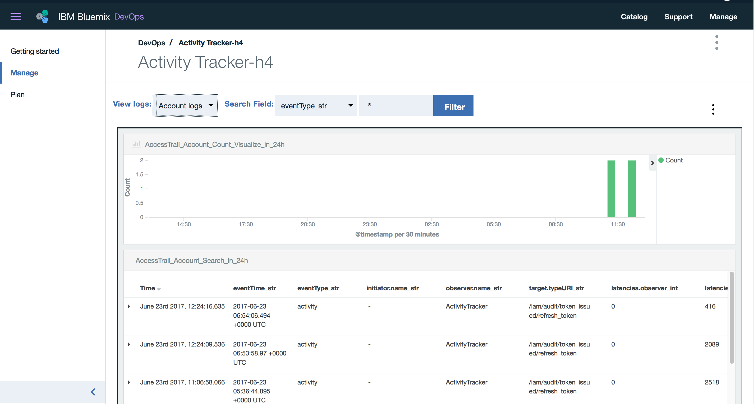
IBM Cloud Activity Tracker
Based on Cloud Auditing Data Federation (CADF) standards
Capture, Store, View, Search and Monitor all API activity in a single place
Review the trail of your cloud activities
Integrate with Enterprise SIEM or export data and generate an audit trail report
Configure the level of detail captured for API calls
Uses open technology viewers to analyze and interact with data creating dynamic dashboards
https://console.bluemix.net/catalog/services/activity-tracker

Slide 15
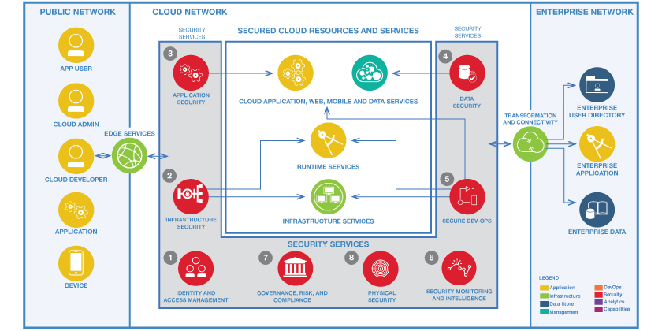
Reference Architecture & Prescriptive Guidance
Identity & Access
Network Security
Data Security
Application Security
Secure Dev-Ops
Security Intelligence & Monitoring
Governance, Risk & Compliance
https://developer.ibm.com/cloudarchitecture/docs/security/

Slide 16
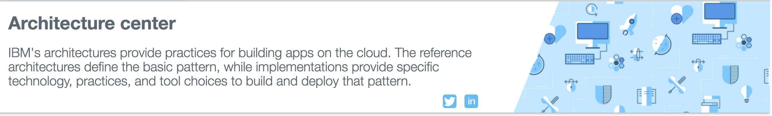
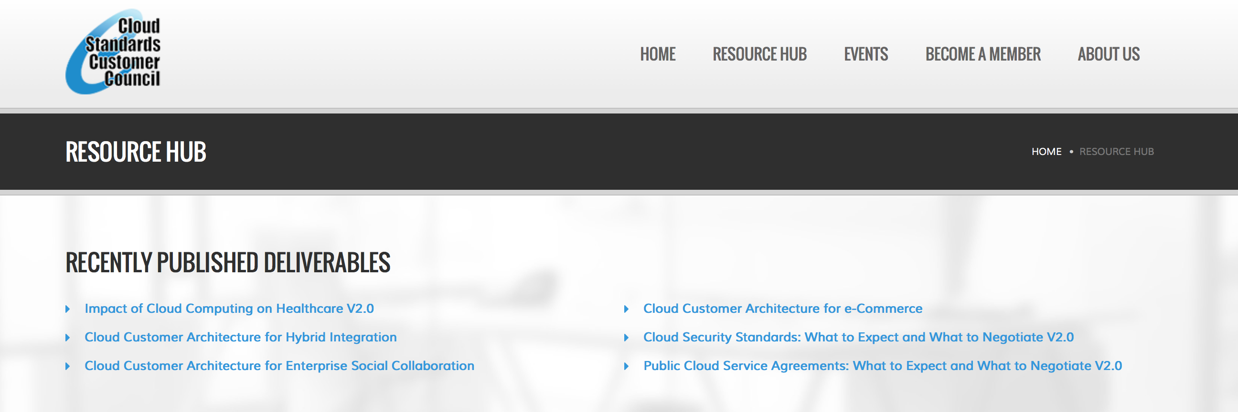
Resources
550+
https://www.ibm.com/devops/method/category/architectures/
CSCC Security Whitepapers
companies are participating
IBM Cloud Architecture Center - Security Guide https://developer.ibm.com/cloudarchitecture/docs/security/
Bluemix Platform Security https://console.ng.bluemix.net/docs/security/index.html#security
Bluemix Security Services
http://www.ibm.com/cloud-computing/bluemix/security
http://www.cloud-council.org/resource-hub.htm

Slide 17
IBM Bluemix Platform Security Services empowers the developer to build and deliver secure applications and services
Multi-Cloud hybrid approach will be the new normal and consistency in architecture and trust is the key enabler
Cloud security policies and requirements are increasingly driven by data classifications and type of workloads
Cloud’s shared-responsibility model impacts enterprises approach to Cloud adoption
Risk management and compliance continue to be core driving factors
Cloud Security

Slide 18


Please give us your valuable feedback
http://ibm.biz/devconnect17

Slide 19


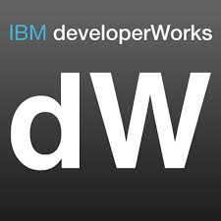

Stay Connected and continue coding !
Code & instructions available here https://github.com/IBMDevConnect17/
Join our Meetup groups
Mumbai : https://www.meetup.com/Cloud-Mumbai-Meetup/
Hyderabad: https://www.meetup.com/Hyderabad-Cognitive-with-Cloud
Bangalore : https://www.meetup.com/IBMDevConnect-Bangalore
Join developerWorks India Community
https://developer.ibm.com/in/
Check out the cool developer journeys
https://developer.ibm.com/code/
Join our Slack team and stay in touch with the experts
https://ibmdevconnect.slack.com
Send in your request to - http://ibm.biz/slackrequest

Slide 20
Notices and disclaimers
Copyright © 2017 by International Business Machines Corporation (IBM). No part of this document may be reproduced or transmitted in any form without written permission from IBM.
U.S. Government Users Restricted Rights — use, duplication or disclosure restricted by GSA ADP Schedule Contract with IBM.
Information in these presentations (including information relating to products that have not yet been announced by IBM) has been reviewed for accuracy as of the date of initial publication and could include unintentional technical or typographical errors. IBM shall have no responsibility to update this information. This document is distributed “as is” without any warranty, either express or implied. In no event shall IBM be liable for any damage arising from the use of this information, including but not limited to, loss of data, business interruption, loss of profit or loss of opportunity. IBM products and services are warranted according to the terms and conditions of the agreements under which they are provided.
IBM products are manufactured from new parts or new and used parts. In some cases, a product may not be new and may have been previously installed. Regardless, our warranty terms apply.”
Any statements regarding IBM's future direction, intent or product plans are subject to change or withdrawal without notice.
Performance data contained herein was generally obtained in a controlled, isolated environments. Customer examples are presented as illustrations of how those customers have used IBM products and the results they may have achieved. Actual performance, cost, savings or other results in other operating environments may vary.
References in this document to IBM products, programs, or services does not imply that IBM intends to make such products, programs or services available in all countries in which IBM operates or does business.
Workshops, sessions and associated materials may have been prepared by independent session speakers, and do not necessarily reflect the views of IBM. All materials and discussions are provided for informational purposes only, and are neither intended to, nor shall constitute legal or other guidance or advice to any individual participant or their specific situation.
It is the customer’s responsibility to insure its own compliance with legal requirements and to obtain advice of competent legal counsel as to the identification and interpretation of any relevant laws and regulatory requirements that may affect the customer’s business and any actions the customer may need to take to comply with such laws. IBM does not provide legal advice or represent or warrant that its services or products will ensure that the customer is in compliance with any law.

Slide 21
Notices and disclaimers continued
Information concerning non-IBM products was obtained from the suppliers of those products, their published announcements or other publicly available sources. IBM has not tested those products in connection with this publication and cannot confirm the accuracy of performance, compatibility or any other claims related to non-IBM products. Questions on the capabilities of non-IBM products should be addressed to the suppliers of those products. IBM does not warrant the quality of any third-party products, or the ability of any such third-party products to interoperate with IBM’s products. IBM expressly disclaims all warranties, expressed or implied, including but not limited to, the implied warranties of merchantability and fitness for a particular, purpose.
The provision of the information contained herein is not intended to, and does not, grant any right or license under any IBM patents, copyrights, trademarks or other intellectual property right.
IBM, the IBM logo, ibm.com, Aspera®, Bluemix, Blueworks Live, CICS, Clearcase, Cognos®, DOORS®, Emptoris®, Enterprise Document Management System™, FASP®, FileNet®, Global Business Services®, Global Technology Services®, IBM ExperienceOne™, IBM SmartCloud®, IBM Social Business®, Information on Demand, ILOG, Maximo®, MQIntegrator®, MQSeries®, Netcool®, OMEGAMON, OpenPower, PureAnalytics™, PureApplication®, pureCluster™, PureCoverage®, PureData®, PureExperience®, PureFlex®, pureQuery®, pureScale®, PureSystems®, QRadar®, Rational®, Rhapsody®, Smarter Commerce®, SoDA, SPSS, Sterling Commerce®, StoredIQ, Tealeaf®, Tivoli® Trusteer®, Unica®, urban{code}®, Watson, WebSphere®, Worklight®, X-Force® and System z® Z/OS, are trademarks of International Business Machines Corporation, registered in many jurisdictions worldwide. Other product and service names might be trademarks of IBM or other companies. A current list of IBM trademarks is available on the Web at "Copyright and trademark information" at: www.ibm.com/legal/copytrade.shtml.

